Slide 1
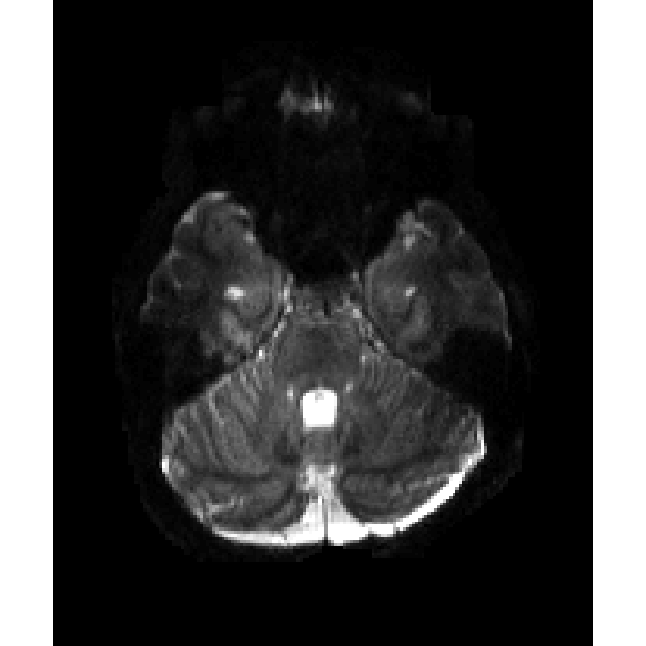
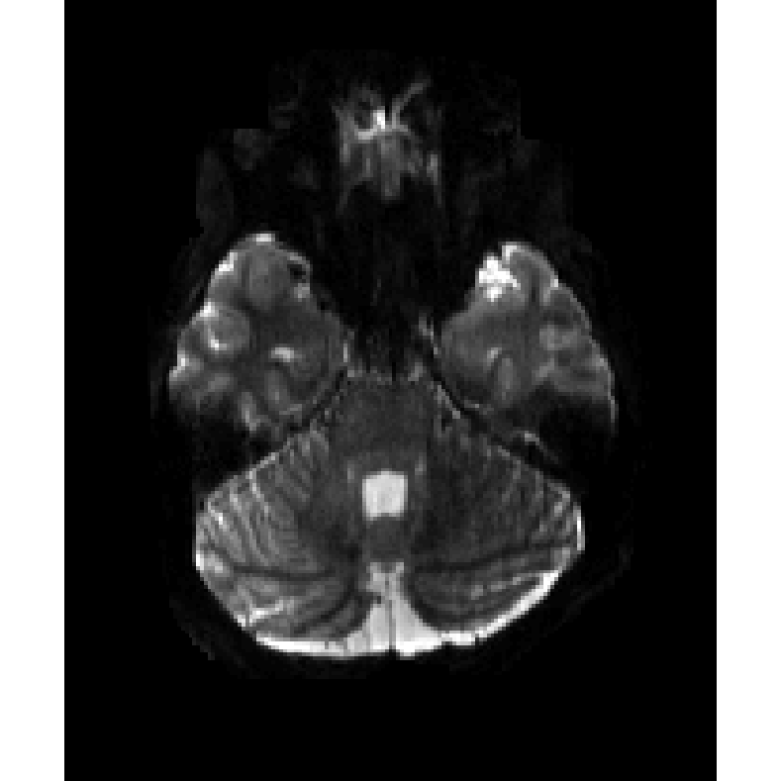
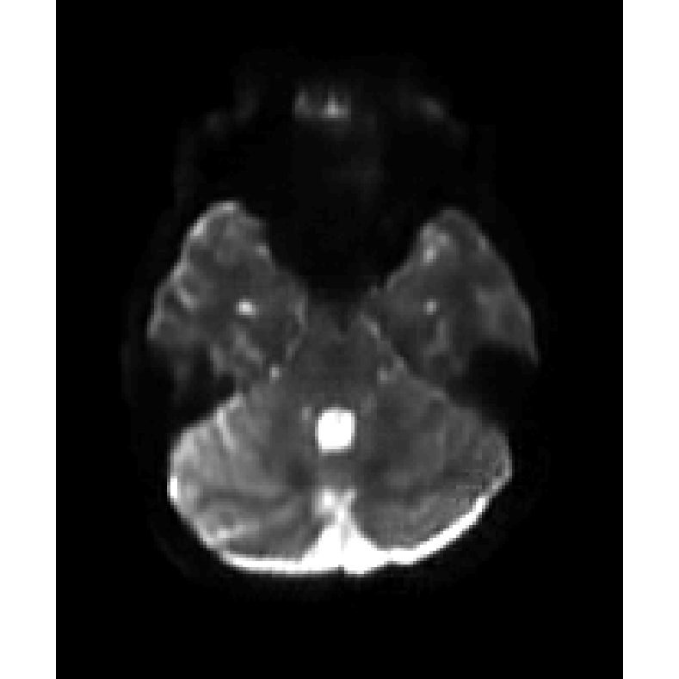
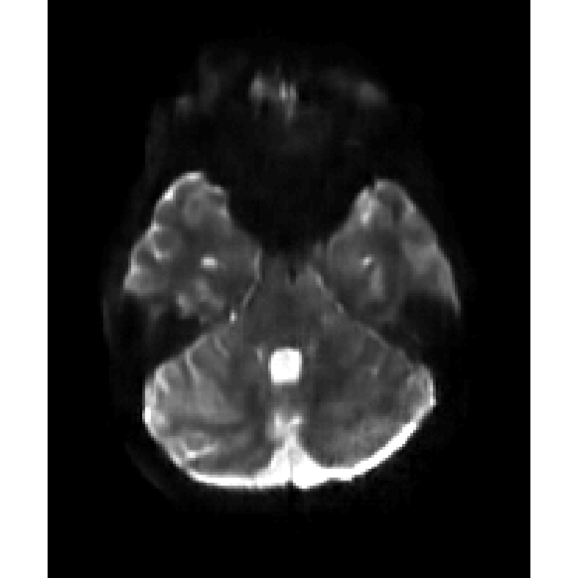
b=0
1TX
pTX
L1
L2

Slide 2
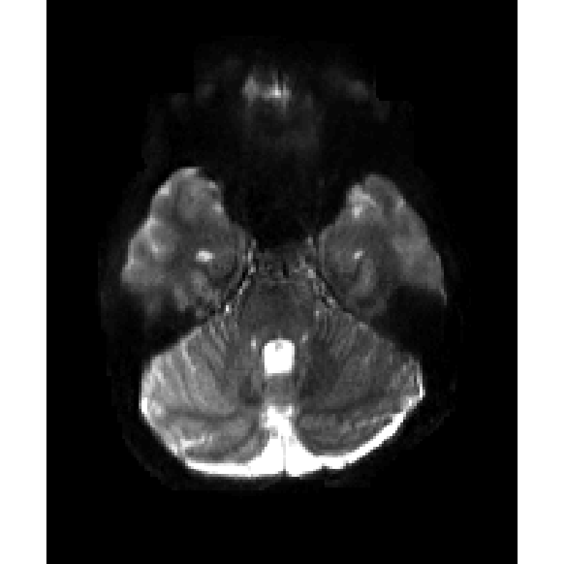
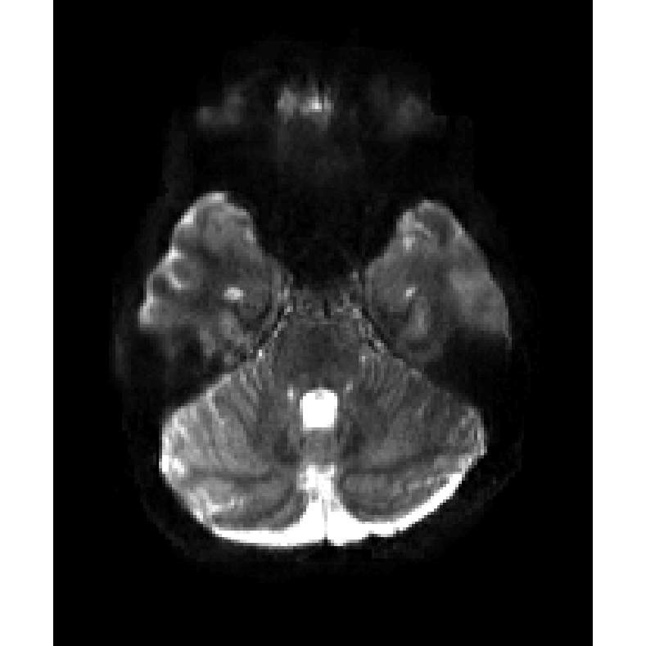
b=0
1TX
pTX
L1-residual
L2-residual

Slide 3
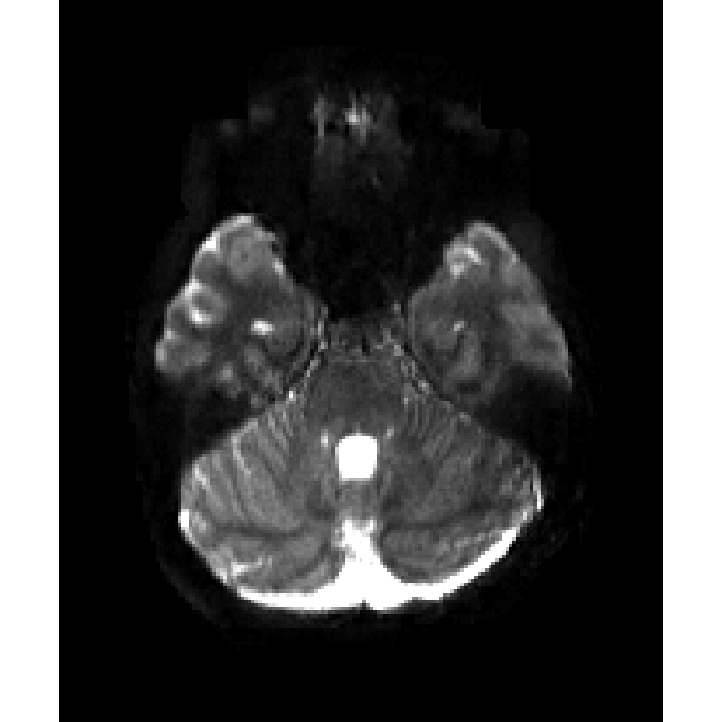
b=0
1TX
pTX
L1-residual-T1W
L1-residual-T1W

Slide 4
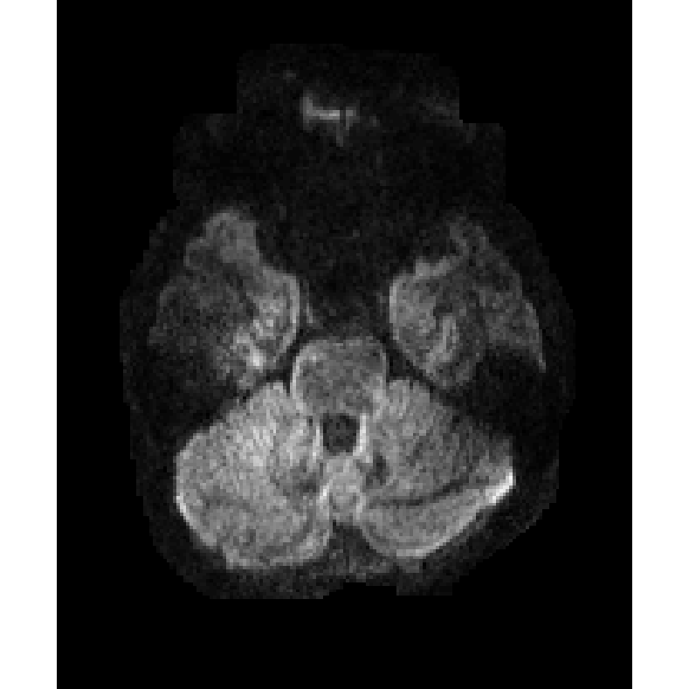
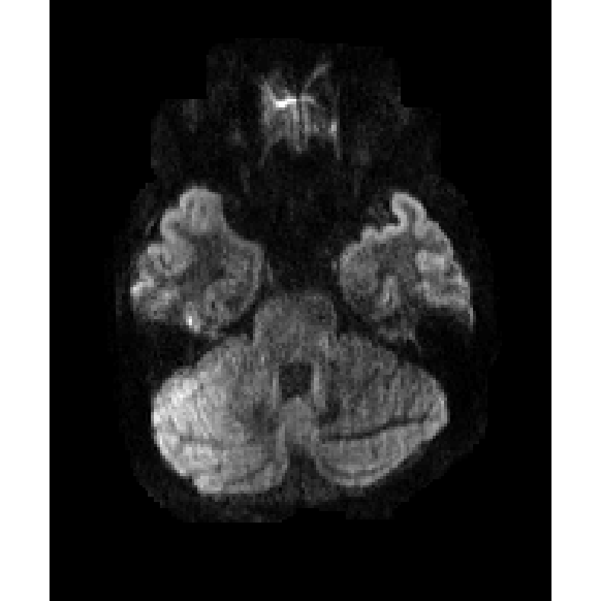
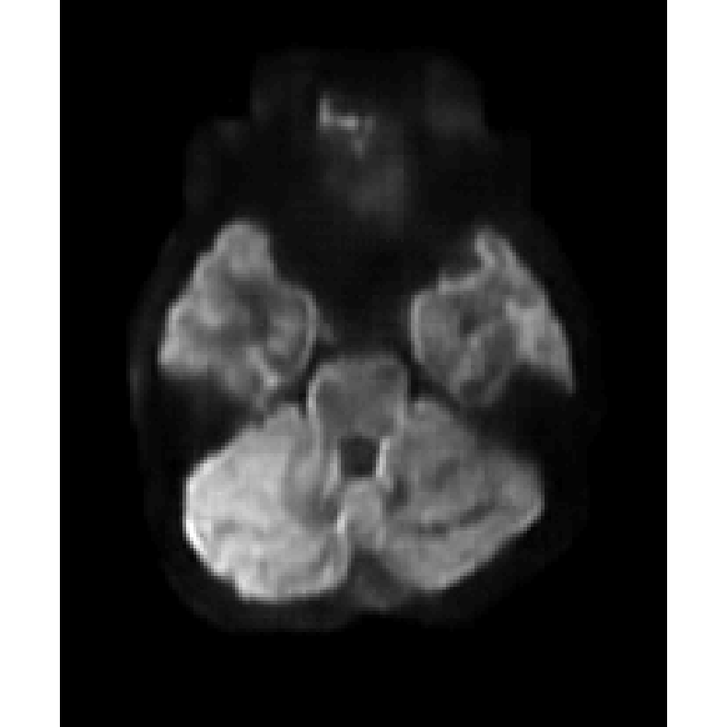
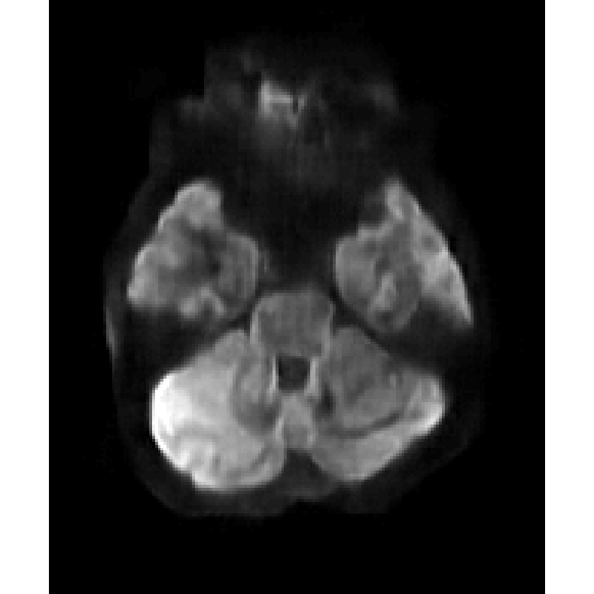
b=1000
1TX
pTX
L1
L2

Slide 5
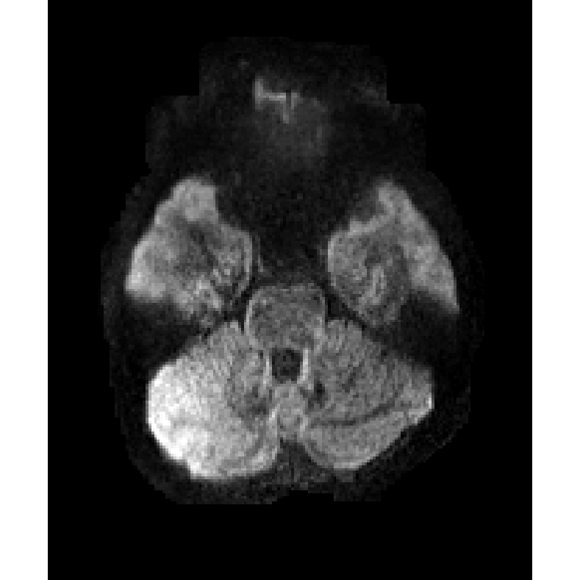
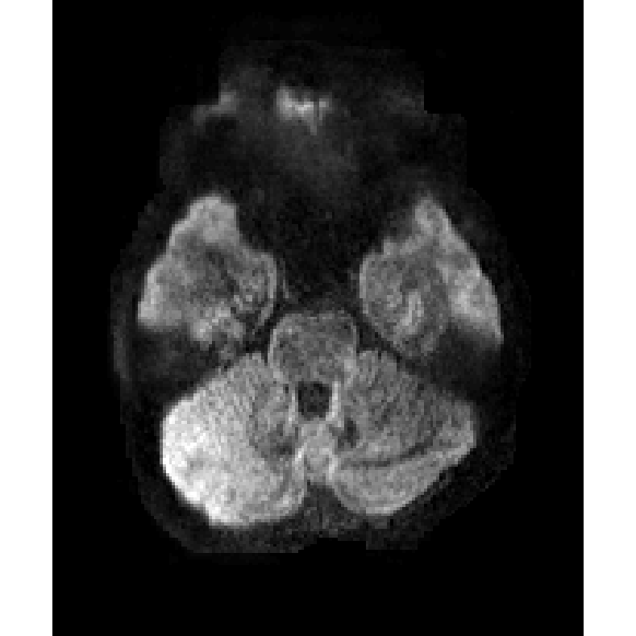
b=1000
1TX
pTX
L1-residual
L2-residual

Slide 6

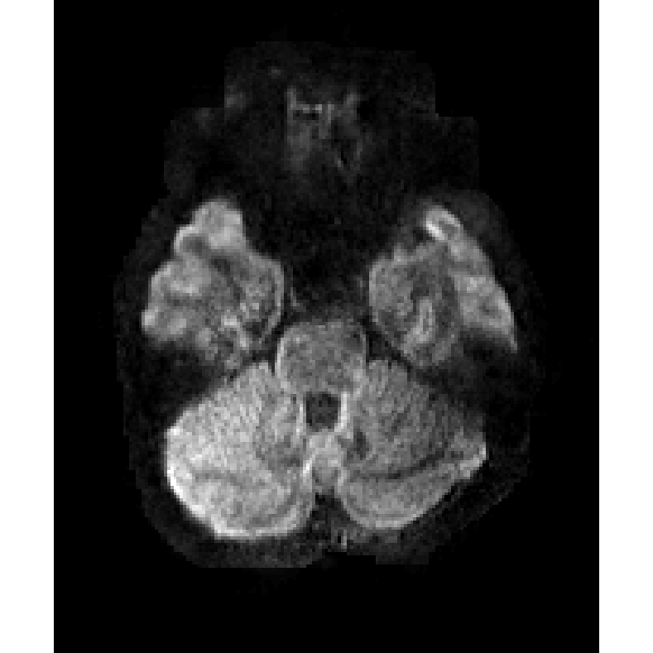
b=1000
1TX
pTX
L1-residual-T1W
L2-residual-T1W

Slide 7
1TX
pTX
L1-residual
L2-residual
1TX
pTX
L1-residual-T1W
L2-residual-T1W

Slide 8
1TX
pTX
b=1000
L1
L1-residual
L1-residual-T1W

Slide 9
1TX
pTX
b=0
L1
L1-residual
L1-residual-T1W

Slide 10
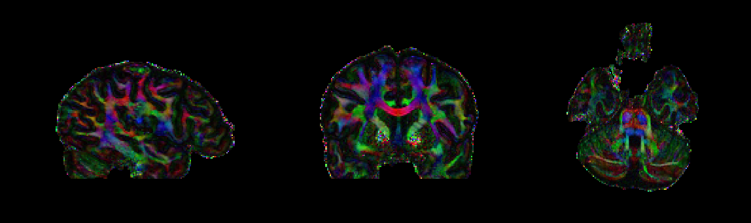
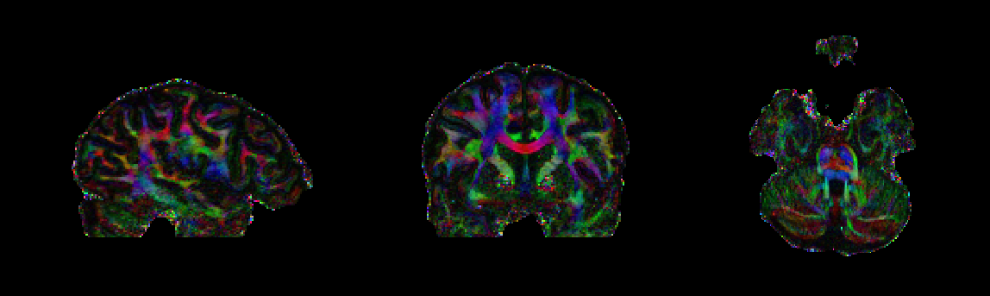
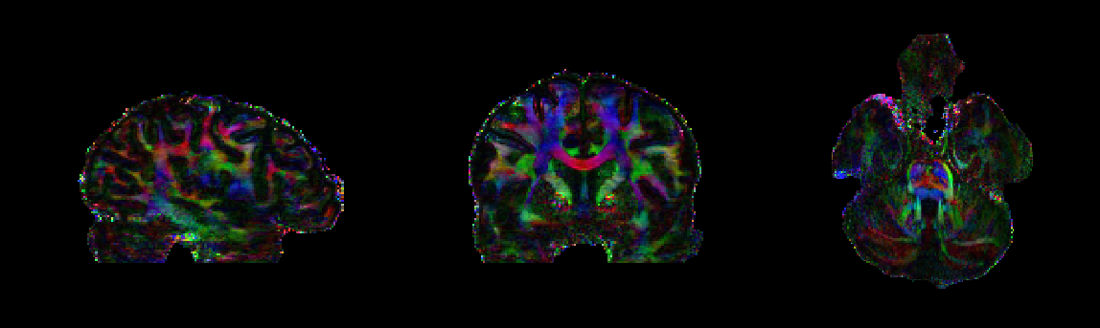
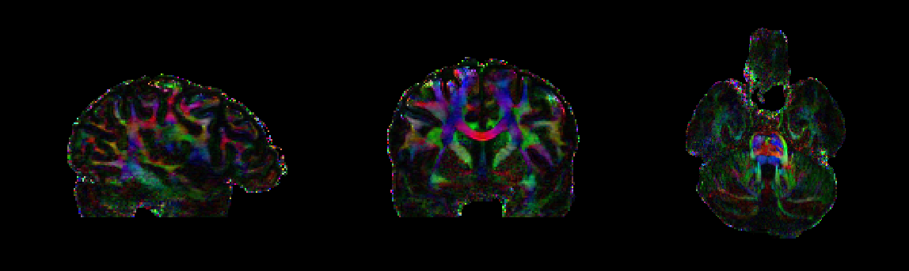
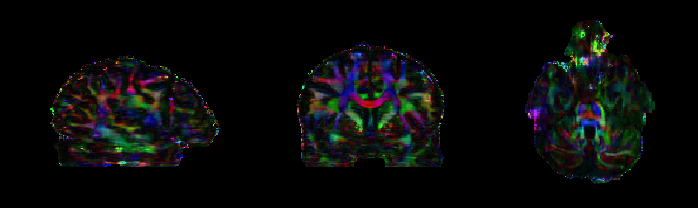
pTX
sTX
L1-residual
L1-residual-T1W
L2

Slide 11
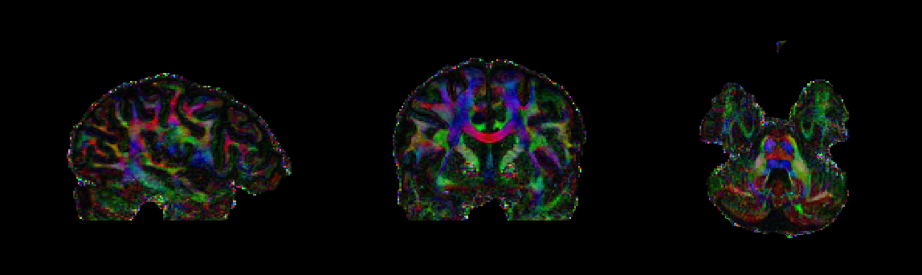
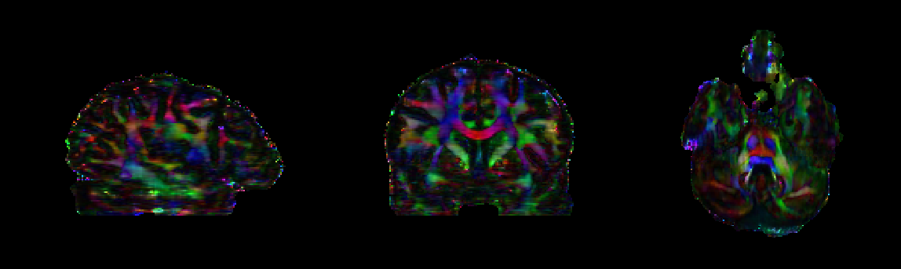
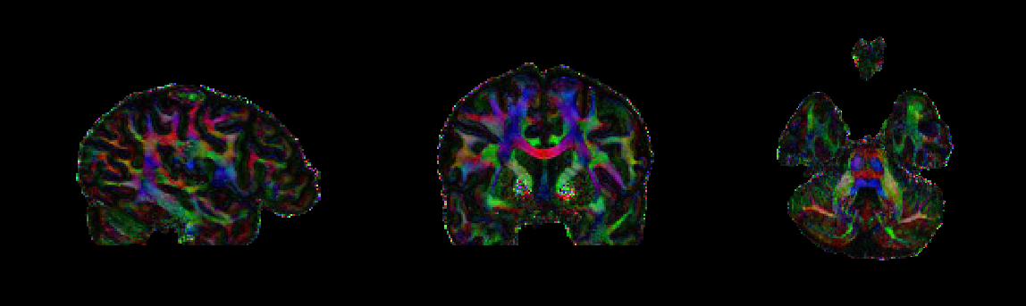
1TX
L2
pTX

Slide 12
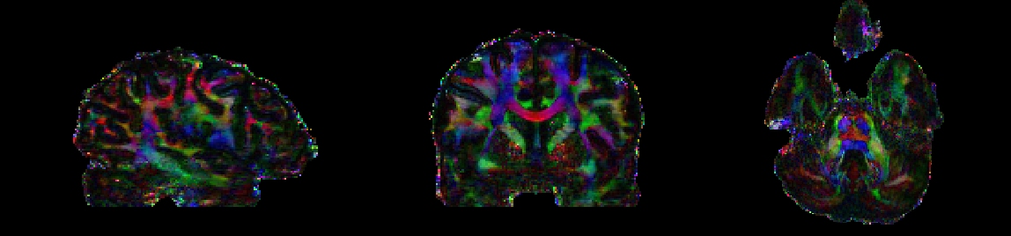
1TX
L2-residual
pTX

Slide 13
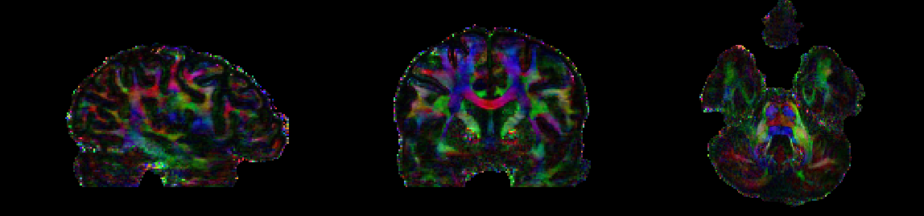
1TX
L1-residual
pTX

Slide 14
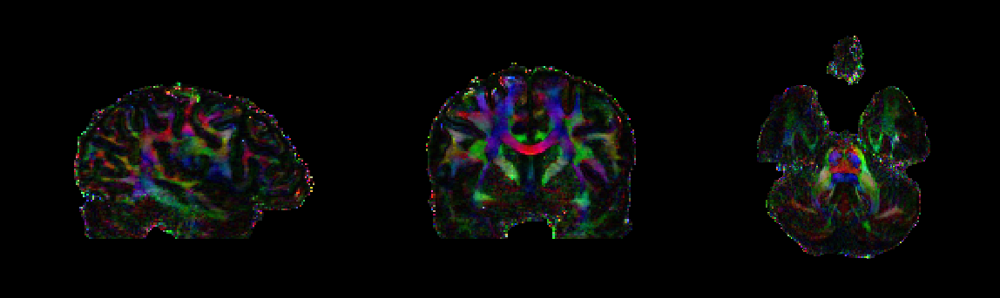
1TX
L2-residual-T1W
pTX

Slide 15
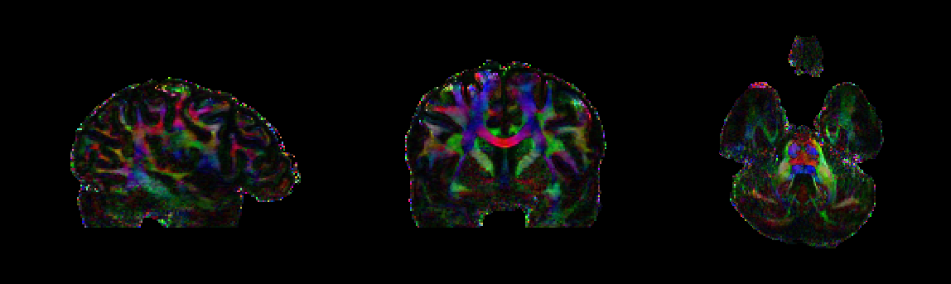
1TX
L1-residual-T1W
pTX

Slide 16
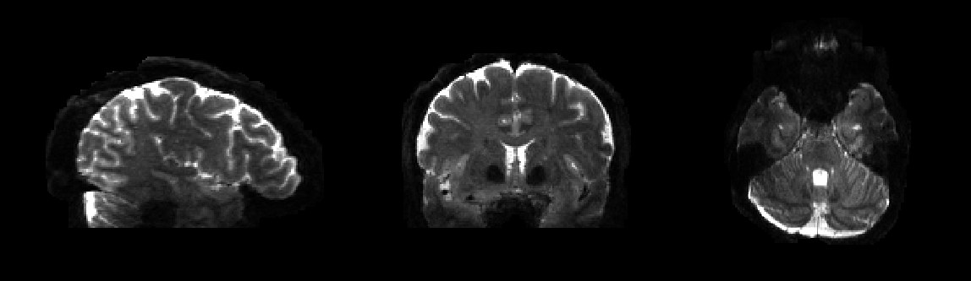
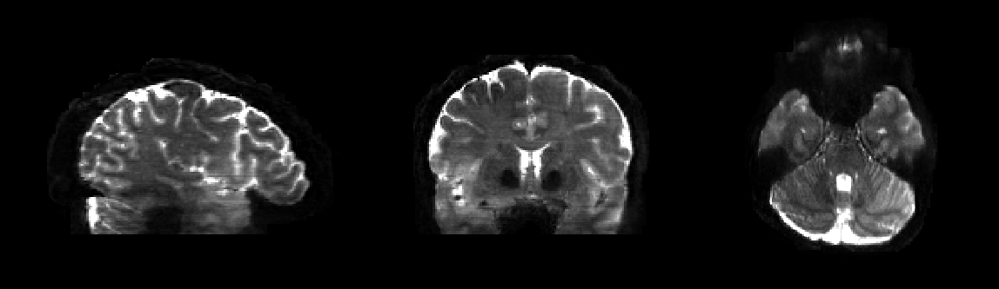
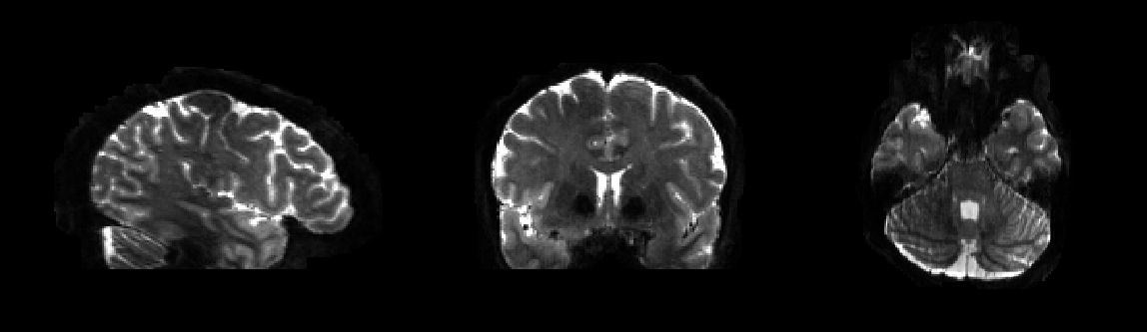
1TX
L1-residual
pTX

Slide 17
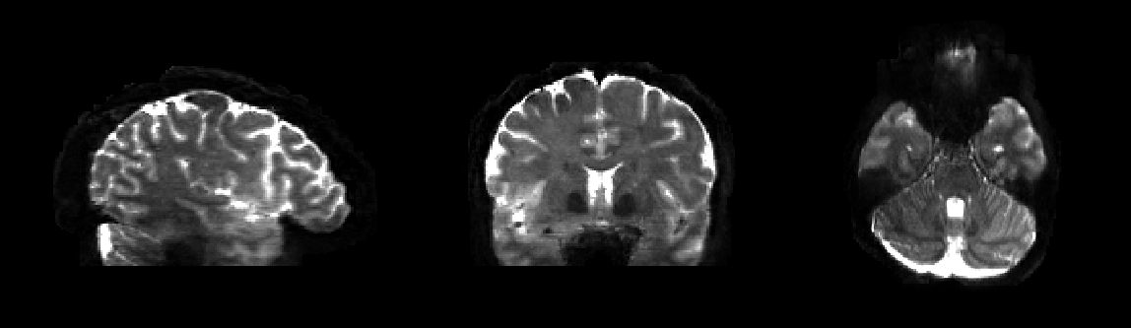
1TX
L1-residual-T1W
pTX

Slide 18
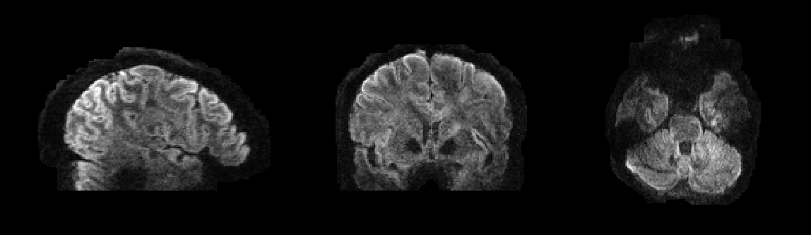
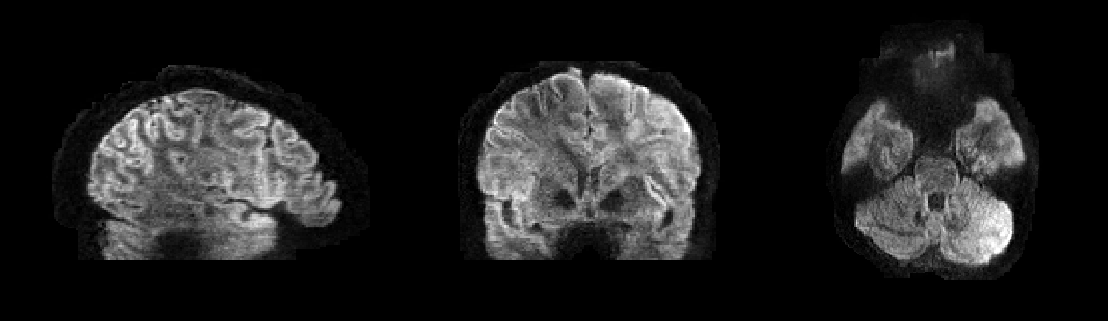
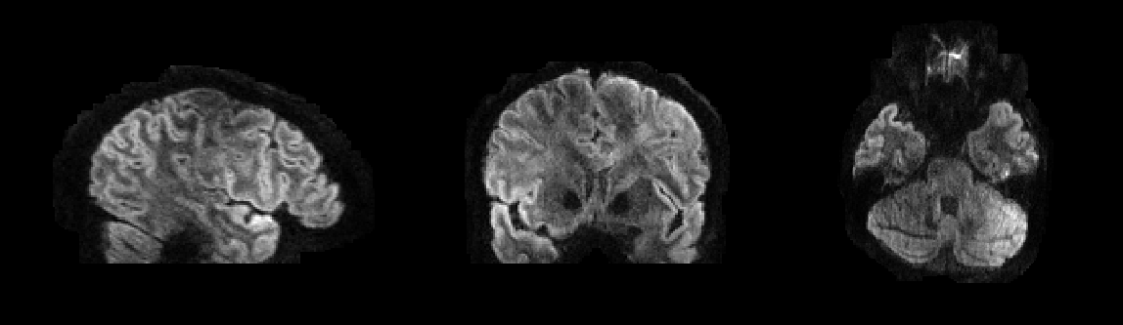
1TX
L1-residual
pTX

Slide 19
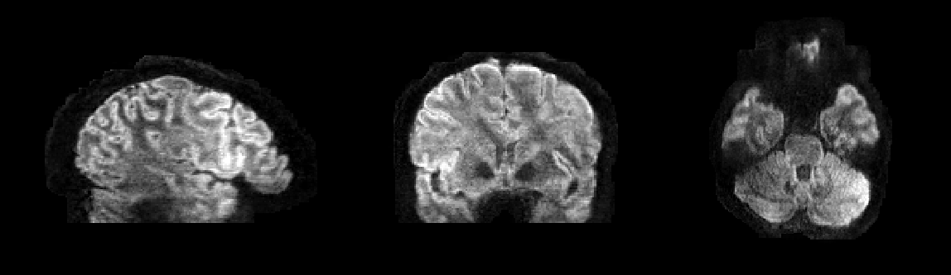
1TX
L1-residual-T1W
pTX

Slide 20
1TX
L1-residual
pTX

Slide 21
1TX
L1-residual-T1W
pTX

Slide 22
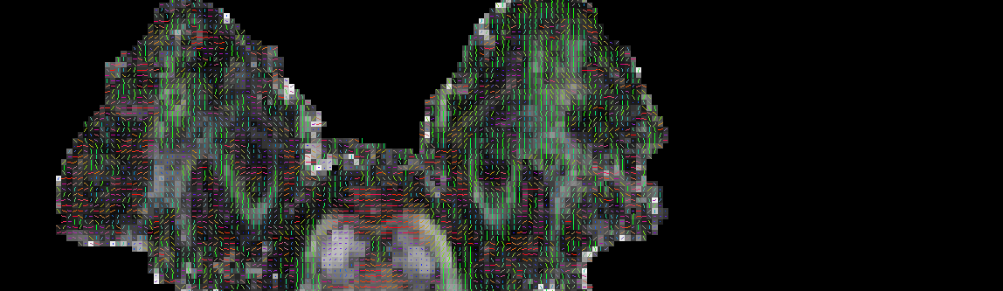
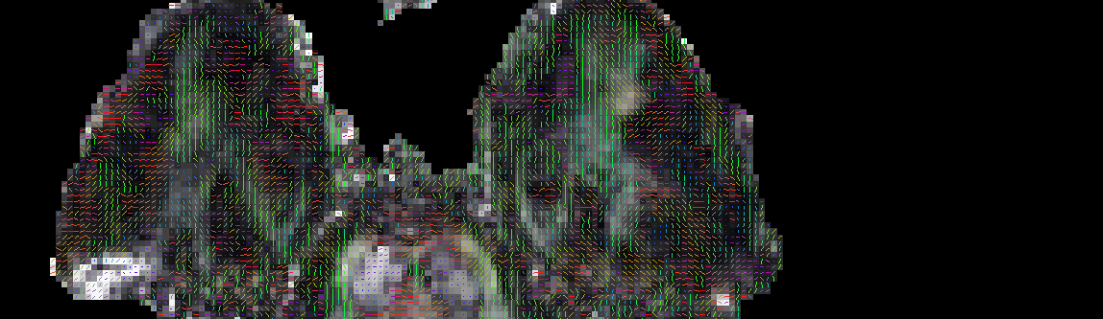
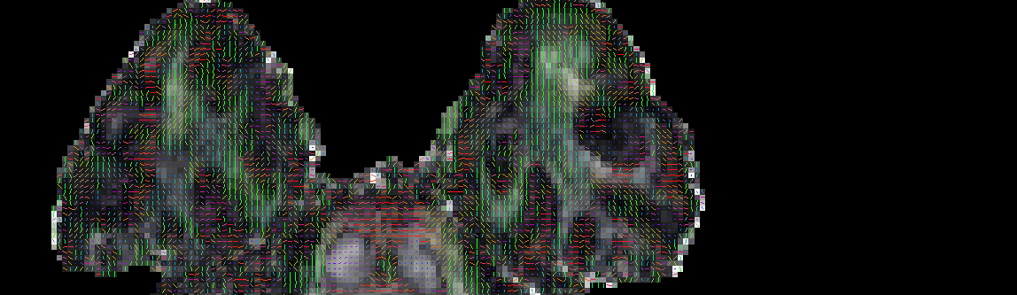
1TX
L2-residual
pTX

Slide 23
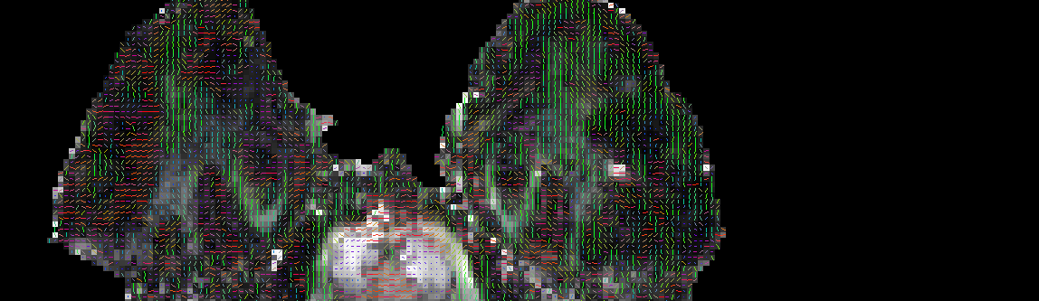
1TX
L2-residual
-T1w
pTX

Slide 24
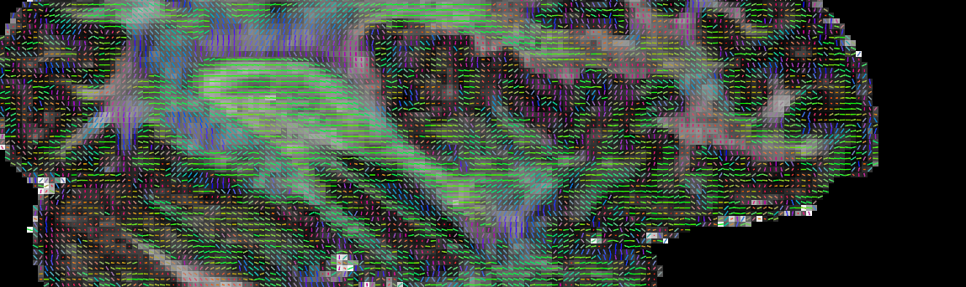
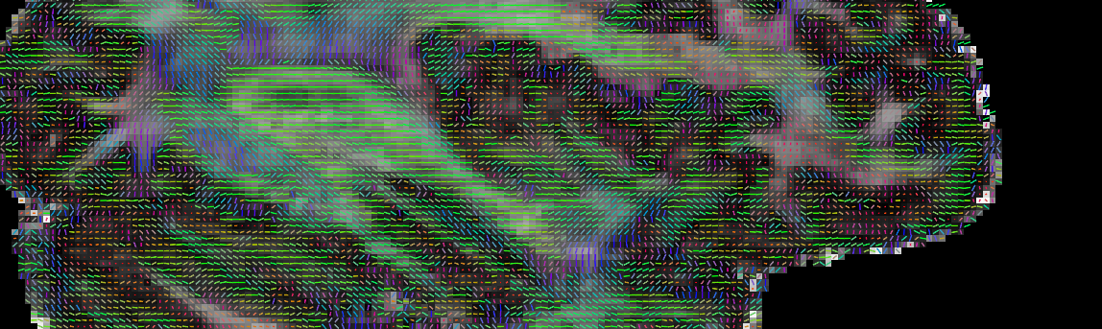
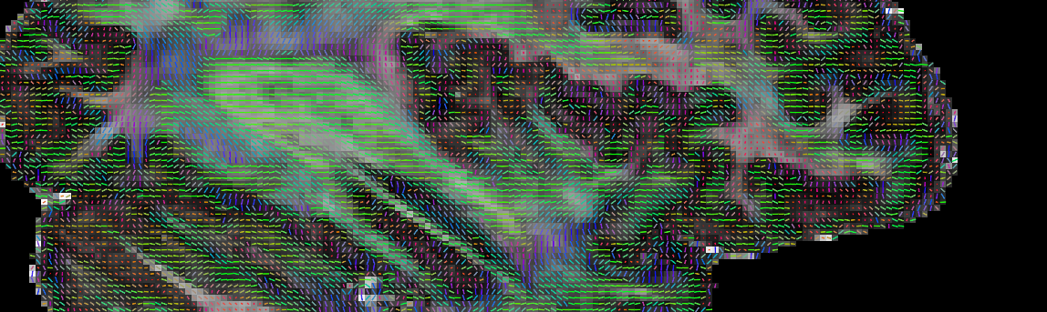
1TX
L2-residual
pTX

Slide 25
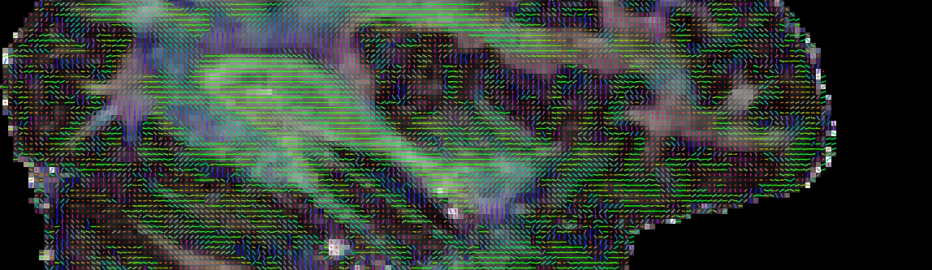
1TX
L2-residual
-T1w
pTX

